Slide 1
Test plan discussion
Converter

Slide 2
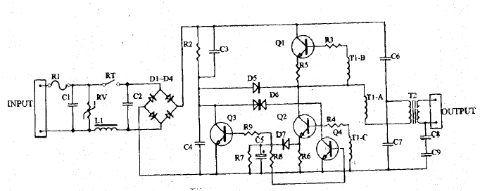
Circuit Diagram- Type 1

Slide 3
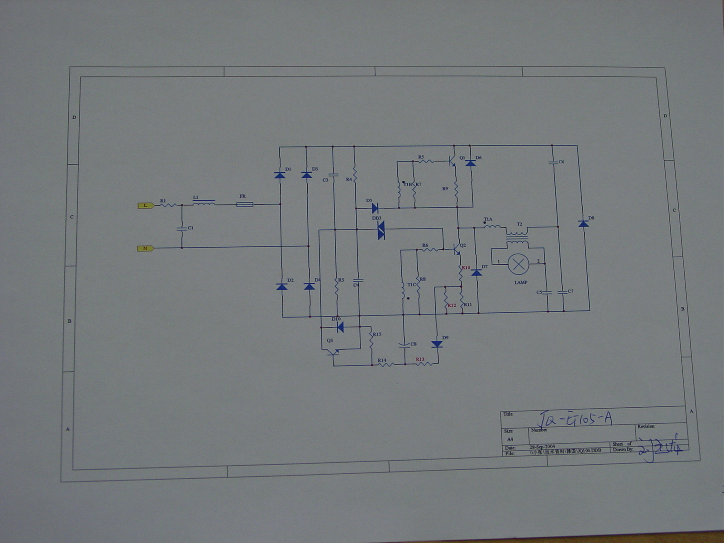
Circuit Diagram Type 2

Slide 4
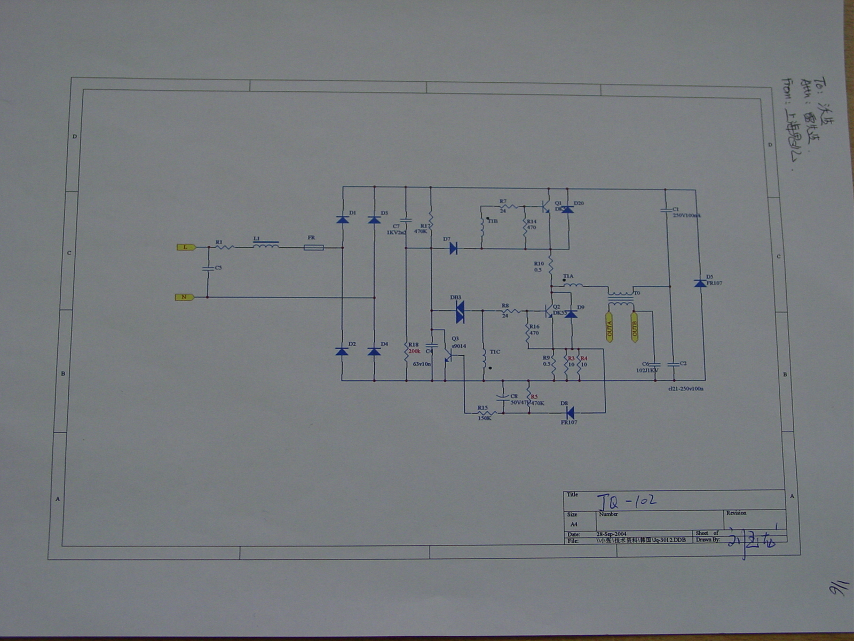
Circuit Diagram Type 3

Slide 5
Disturbance Source
Transistor
Oscillator-circuit

Slide 6
Sensitive components for immunity test
Transistor
Oscillator-circuit

Slide 7
Applicable standards
Light standard
EN 55015
EN 61547
EN 61000-3-2
EN 61000-3-3

Slide 8
Test items/operation modes
Disturbance voltage
  AC Mains
  Output port (normal condition)
  Radiated Disturbance
No Click test

Slide 9
Test items/operation modes
Harmonics(Class C)
  Adjust to find the maximum disturbance
No test on Flicker
ESD
  According to the sensitive component, TRIAC should be adjust to 30%, 60%, 90% luminous intensity
EFT
  Same as ESD
CS
  Same as ESD
Surge
  Same as ESD, Power<25W, 0.5KV for L-N; Power>25W, KV for L-N;
Dips
  Same as ESD
RS
  Same as ESD

